Slide 1
Conceptual tool kit for systems biology part 1
Copyright by Prof. Lee Bardwell, Univ. of Calif., Irvine
Functions
VERSION:
10 Jan 2019
Exponential Function
Saturating Function
Reactions/Equations
Zero order chemical reaction
First order chemical reaction
Second Order Chemical Reaction
Stringing simple reactions together
0+1 = gene regulation
1+1 = interconversion
2+1 = binding
2+1+1 = enzyme

Slide 2
Conceptual tool kit for systems biology
Functions
Two functions we will come across again and again
Exponential Function
Saturating Function
Reactions/Equations
Zero order chemical reaction
First order chemical reaction
Second Order Chemical Reaction
Stringing simple reactions together
0+1 = gene regulation
1+1 = interconversion
2+1 = binding
2+1+1 = enzyme

Slide 3
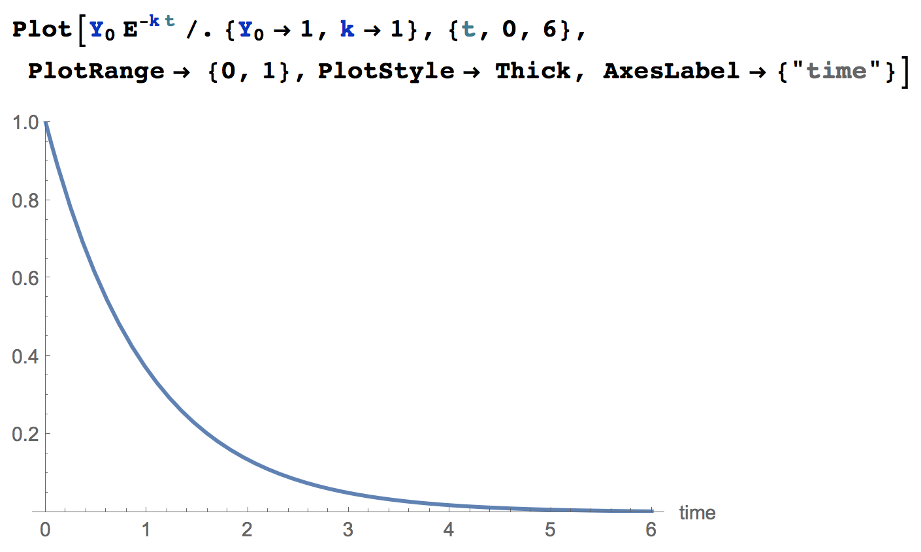
The Exponential Function
Describes how a reaction evolves over time
.
Y(t) = Y₀ e^{-kt}
}
= 1 when t = 0
= 0 when t = Infinity*
There’s an asymptotic limit as t --> Infinity.
The half-time to reach
this limit will be ~0.7/k
* e^{-kt} = 1/e^{kt}

Slide 4
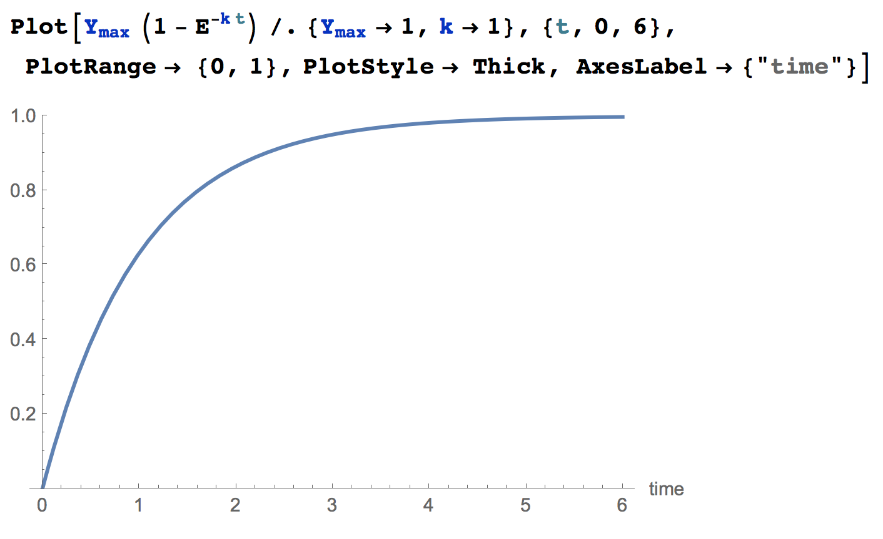
The Exponential Function
Describes how a reaction evolves over time
.
Y(t) = Y_{max} (1-e^{-kt})
}
= 0 when t = 0
= 1 when t = Infin
There’s an asymptotic limit as t --> Infinity.
The half-time to reach
this limit will be ~0.7/k

Slide 5
The Exponential Function
Describes how a reaction evolves over time
.
.
Y(t) = Y₀ e^{-kt}
Y(t) = Y_{max} (1-e^{-kt})
}
}
= 1 when t = 0
= 0 when t = Infin
= 0 when t = 0
= 1 when t = Infin

Slide 6
Characteristic time/half time/half life
Simple exponential functions asymptotically approach a limit as t* → infinity
It will take forever to get to that limit
The characteristic time/half time tells us how long it takes to get half way to that limit
In one half-time, from wherever you start, you will get half way to where you will eventually end up

Slide 7
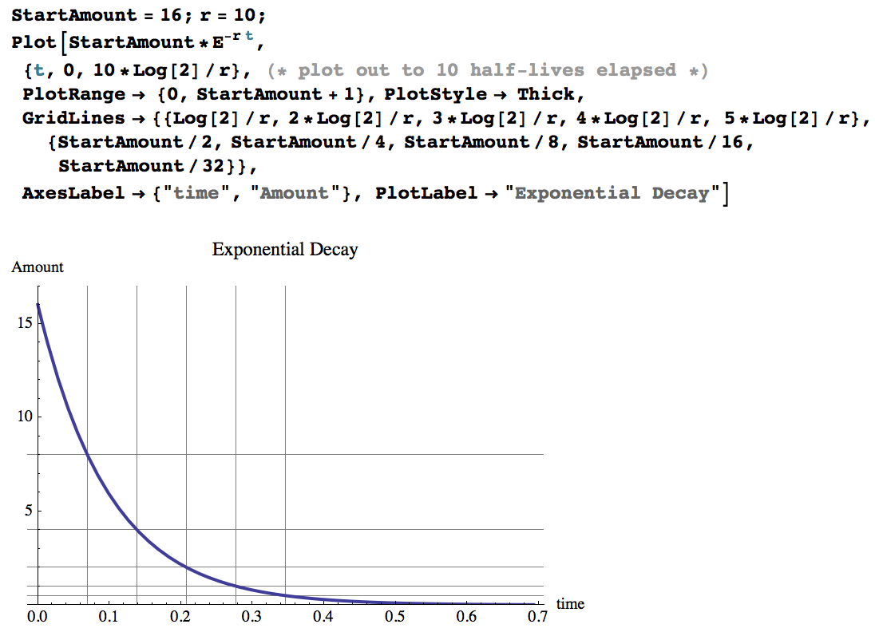
Exponential Functions
.
Y(t) = StartAmount e^{-rt}
Exponential Decay
Associated Notebook:
“Saturating+Hill+ExponentialFxns.nb”

Slide 8
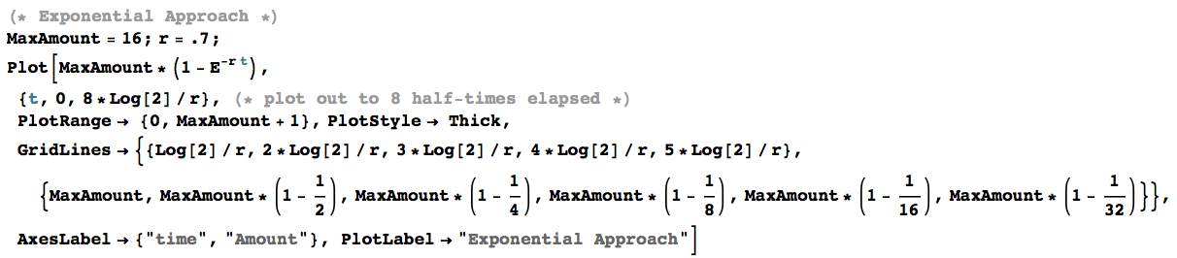
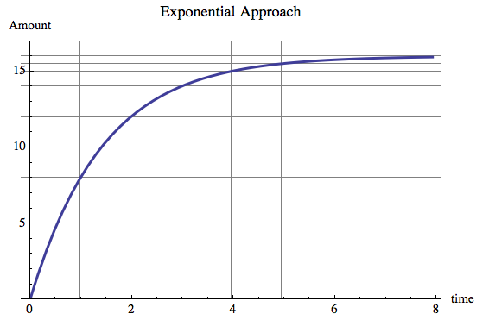
Exponential Functions
Exponential Approach
.
Y(t) = MaxAmount (1-e^{-kt})
MaxAmount
Notes:
‹#›

Slide 9
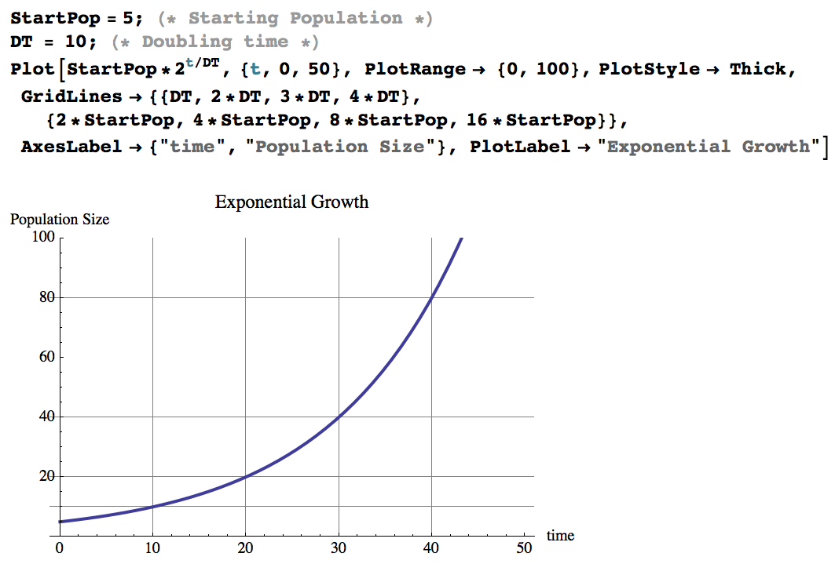
Exponential Functions
Exponential growth

Slide 10
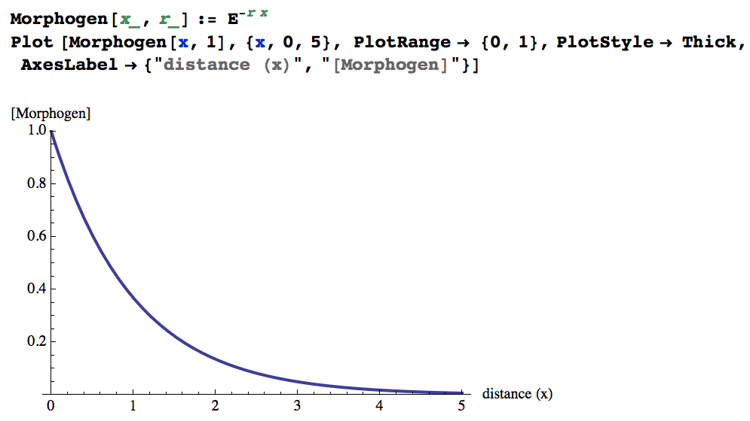
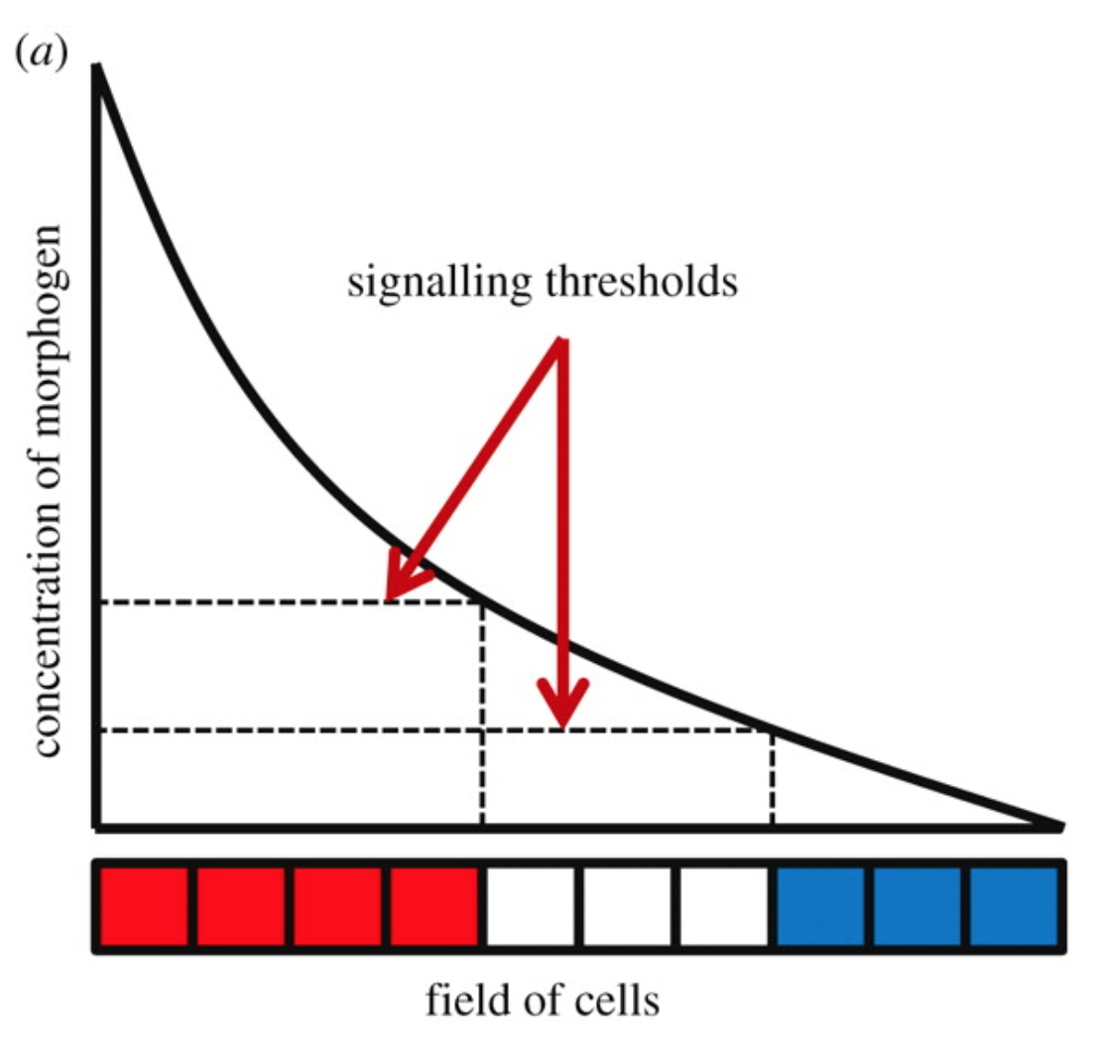
Exponential Functions
Also often describe the shape of gradients
y =
e ^{-r x}
Source
(sink is everywhere)

Slide 11
Concept Summary
Time courses of biochemical reactions can be represented as simple exponential functions (or as more complicated combinations of exponential functions)
Exponential functions are also used to understand other phenomenon (population growth, gradients)
A useful way to start to comprehend functions is to plug in key and extreme values for the variables (such as t)

Slide 12
Tool kit for systems biology
Functions
Exponential Function ✓
Saturating function*
With just these 3 reactions we can model essentially any biochemical pathway
Reactions/Equations
Zero order chemical reaction
First order chemical reaction
Second Order Chemical Reaction
Stringing simple reactions together
0+1 = gene regulation
1+1 = interconversion
2+1 = binding
2+1+1 = enzyme
* Toolkit part 2

Slide 13
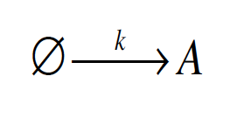
Tool kit for systems biology: Reactions
1. Zero Order chemical reaction
A is created at constant rate (k)
e.g. transcript or protein prodxn, pumping by a saturated pump.
k, [A] = parameters
k = fixed parameter
The value of k does not change as the reaction progresses
[A] = variable parameter or state variable
The value of [A] does change as as the reaction progresses

Slide 14
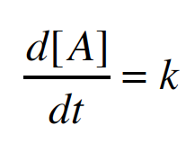
Tool kit for systems biology: Reactions
1. Zero Order chemical reaction
A is created at constant rate (k)
e.g. transcript or protein prodxn, pumping by a saturated pump
Rate equation
This is a chemical reaction that is zero order because the rate does not depend on the variable parameter
Here, rate = k
The rate at which [A] changes as a function of time is equal to k

Slide 15
Tool kit for systems biology: Reactions
1. Zero Order chemical reaction
A is created at constant rate (k)
e.g. transcript or protein prodxn, pumping by a saturated pump
Rate equation
This is a differential equation that is
Ordinary (no partial derivatives)
First order (only first derivatives)
Linear
The rate at which [A] changes as a function of time is equal to k

Slide 16
Tool kit for systems biology: Reactions
1. Zero Order chemical reaction
A is created at constant rate (k)
e.g. transcript or protein prodxn, pumping by a saturated pump
Rate equation
The rate at which [A] changes as a function of time is equal to k
The rate has units of concentration*/time
Here, the rate coefficient also has units of concentration*/time
*or, more generally, amount

Slide 17
Tool kit for systems biology: Reactions
1. Zero Order chemical reaction
A is created at constant rate (k)
e.g. transcript or protein prodxn, pumping by a saturated pump
Rate equation
Exact Solution
[A](t) = [A]₀ + kt
The [A] at any time t is equal to the starting amount plus k times t

Slide 18
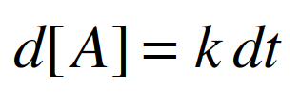
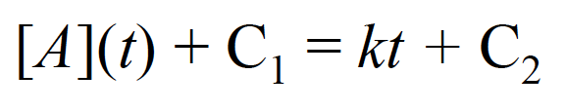
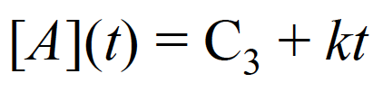
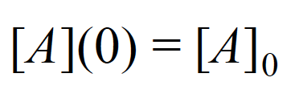
How do we solve it?
Rewrite
Integrate each side
Combine arbitrary constants
Decide on initial conditions (IC’s)
The IC’s and behavior of fxn at t = 0 set the value of the arbitrary constant
[A](t) = [A]₀ + kt
See “Bardwell Lecture Notes 1” for a more in depth explanation

Slide 19
Unit check
k
μM/s
μM/s
✓
[A](t) = [A]₀ + kt
μM
μM
.
μM/s
s
✓
Initial condition check
[A](t =0) = [A]₀
✓

Slide 20
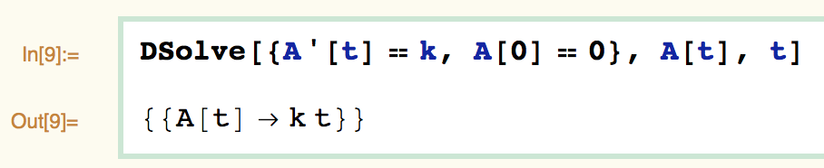
How do we get Mathematica to solve it?
Associated Notebook:
“Basic Chemical Reactions.nb”

Slide 21
How do we get Mathematica to solve it?
DSolve is a
Mathematica function.
Differential
equation
Initial
condition
Solve for A[t]
As a function of t
Associated Notebook:
“Basic Chemical Reactions.nb”

Slide 22
How do we get Mathematica to solve it?
DSolve is a
Mathematica function.
Differential
equation
Initial
condition
Solve for A[t]
As a function of t
Associated Notebook:
“Basic Chemical Reactions.nb”
Notes:
‹#›

Slide 23
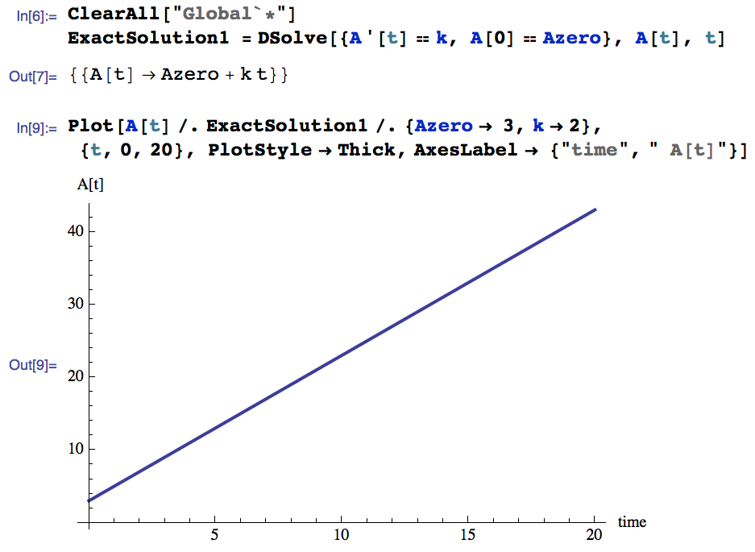
How do we get Mathematica to plot it?
Associated Notebook:
“Basic Chemical Reactions.nb”

Slide 24
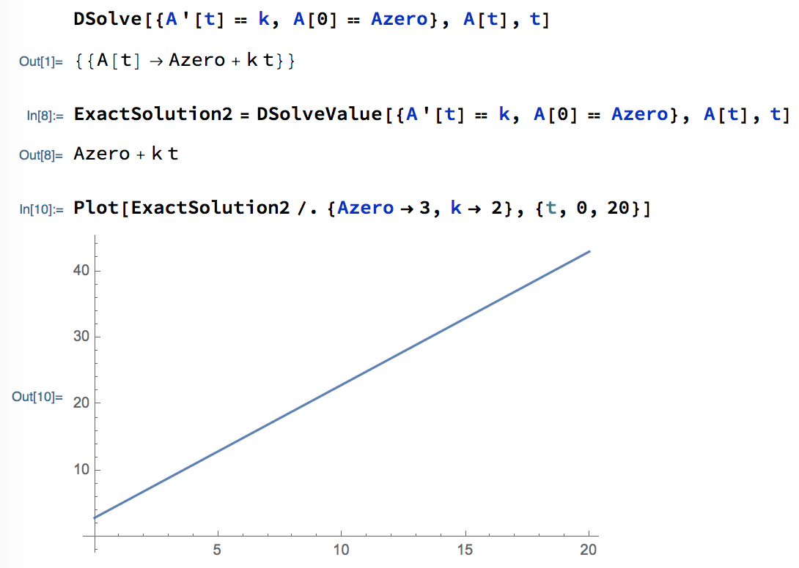
DSolveValue
DSolveValue is a newish Mathematica function
Some people find DSolveValue more intuitive to work with
Almost all of Prof. Bardwell’s examples use DSolve rather than DSolveValue

Slide 25
Tool kit for systems biology: Reactions
k
k
k
A

A B
AB A + B
2. First Order chemical reaction
A is destroyed/converted/exported etc. at at rate proportional to its own concentration*
e.g. transcript or protein degradation, pumping/leaking out (non-saturated), dissociation, something being used up…
First order reaction because rate determined by a single concentration
k is a first order rate coefficient (not a rate) with units of time⁻¹
*Collision theory of chemical reactions / law of mass action
Notes:
‹#›

Slide 26

First-order decay simulation
36
balls
Notes:
‹#›

Slide 27
Tool kit for systems biology: Reactions
k
k
k
A

A B
AB A + B
2. First Order chemical reaction
A is destroyed/converted/exported etc. at at rate proportional to its own concentration*
e.g. transcript or protein degradation, pumping/leaking out (non-saturated), dissociation, something being used up…
First order reaction because rate determined by a single concentration
k is a first order rate coefficient (not a rate) with units of time⁻¹
Differential equation
Ordinary (no partial derivatives)
First order (only first derivatives)
Linear
d [A]
-k[A]
dt
=
the rate is concentration/time
rate coefficient is 1/time
Don’t confuse rates with rate coefficients !

Slide 28
Tool kit for systems biology: Reactions
k
k
k
A

A B
AB A + B
2. First Order chemical reaction
A is destroyed/converted/exported etc. at at rate proportional to its own concentration*
e.g. transcript or protein degradation, pumping/leaking out (non-saturated), dissociation, something being used up…
First order reaction because rate determined by a single concentration
k is a first order rate coefficient (not a rate) with units of time⁻¹
Differential equation
Ordinary (no partial derivatives)
First order (only first derivatives)
Linear
Exact Solution
d [A]
-k[A]
dt
=
[A](t) = [A]₀ e^{-kt}
*Collision theory of chemical reactions / law of mass action

Slide 29
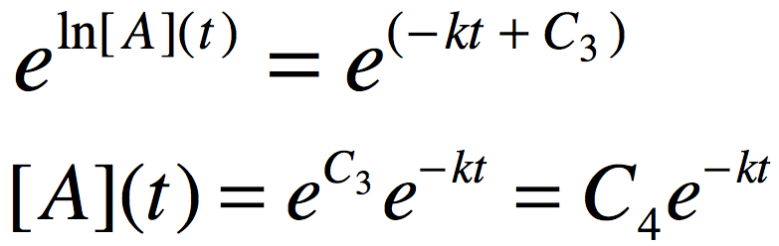
How do we solve it?
d [A]
-k[A]
dt
=
d [A]
-k dt
Rewrite
Integrate each side
Combine arbitrary constants
Exponentiate each side
Decide on initial conditions (IC’s)
The IC’s and behavior of fxn at t = 0 set the value of the arbitrary constant
[A]
=
ln [A] + C₁
-k t + C₂
=
ln [A]
=
-k t + C₃
[A](0) = [A]₀
[A](t) = [A]₀ e^{-kt}
See “Bardwell Lecture Notes 1” for a more in depth explanation

Slide 30
Unit check
d [A]
-k[A]
dt
=
μM/s
μM
s⁻¹
[A](t) = [A]₀ e^{-kt}
μM
μM
.
✓
s⁻¹
s
Hence, dimensionless
Initial condition check
[A](t =0) = [A]₀
✓

Slide 31
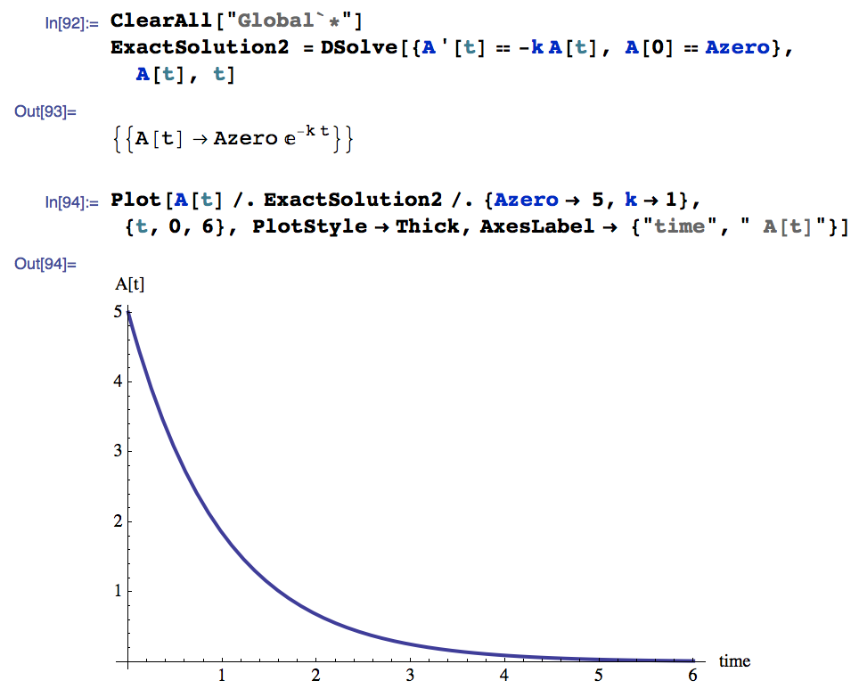
How do we get Mathematica to solve it?
Exponential Decay
.
A(t) = Azero e^{-kt}
Associated Notebook:
“Basic Chemical Reactions.nb”

Slide 32
As with all time course curves…
We can interpret the slope of the curve at a particular moment in time as the rate of the reaction at that moment
Clearly the rate is constantly changing
(because [A] is changing)
d [A](t)
=
-k[A](t)
dt

Slide 33
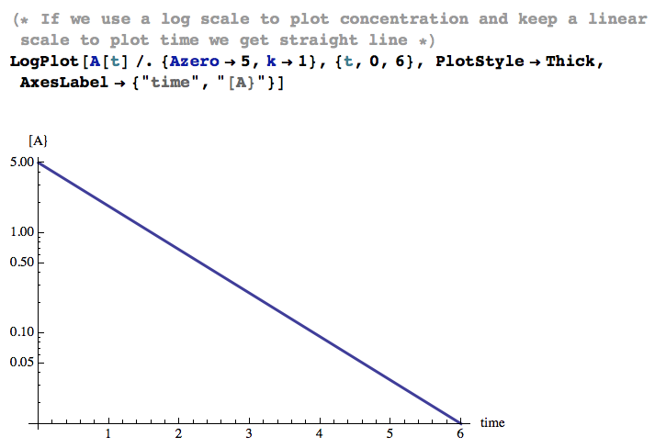

Slide 34
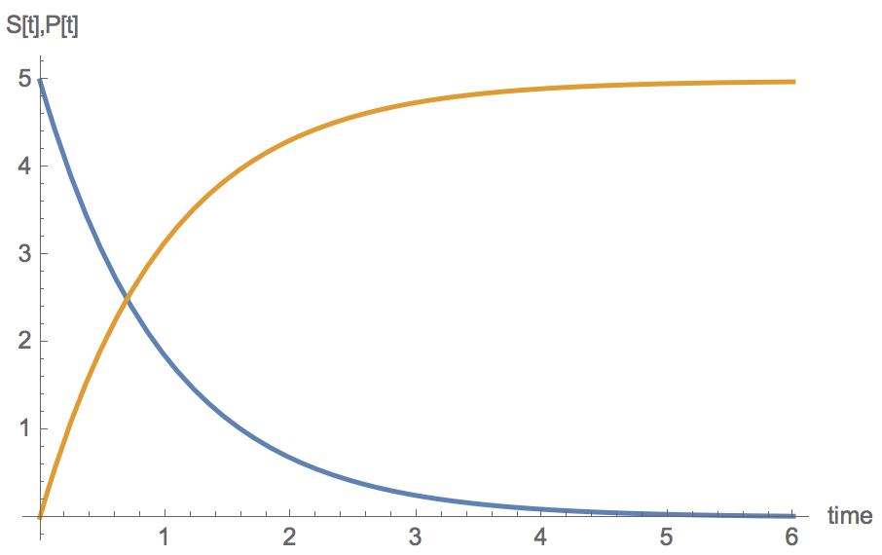
Another use of the first order chemical reaction
k
E + S E + P
This scheme, modeled with a first–order chemical reaction, can be used as the simplest model of an enzyme-catalyzed reaction
This “first order regime” for enzymes is valid when K_{M} >> [S]
[S]’
-k[E][S]
P
=
[P]’
k[E][S]
=
(we assume [E] does not change, i.e. we make a fixed parameter)
S

Slide 35
Concept Summary
For elementary chemical reactions, we can write down a differential equation that expresses the rate of the reaction as a function of the parameters
Specifically, we express the rates of these reactions as a function of…
Variable parameters (a.k.a. state variables)
– concentrations or amounts of reactants/products
in time courses, these are dependent variables, and time is the independent variable
Fixed parameters
Rate coefficients
Hill numbers
Concentrations that do not change
Etc.

Slide 36
Concept Summary
For elementary chemical reactions, we can write down a differential equation that expresses the rate of the reaction as a function of the parameters
Some of these differential equations (i.e. the linear ones) have exact solutions, meaning we get a symbolic equation for the time course of the reaction
Rate coefficients are different than rates

Slide 37
Warm-up exercises
To get you going with Mathematica, make sure you can do this in your own notebook:
1a. Plot a straight line
1b. Use DSolve to solve [A]’(t) = k
Output you should get
On some platforms (e.g. Linux), use a’[t] instead of A’[t]

Slide 38
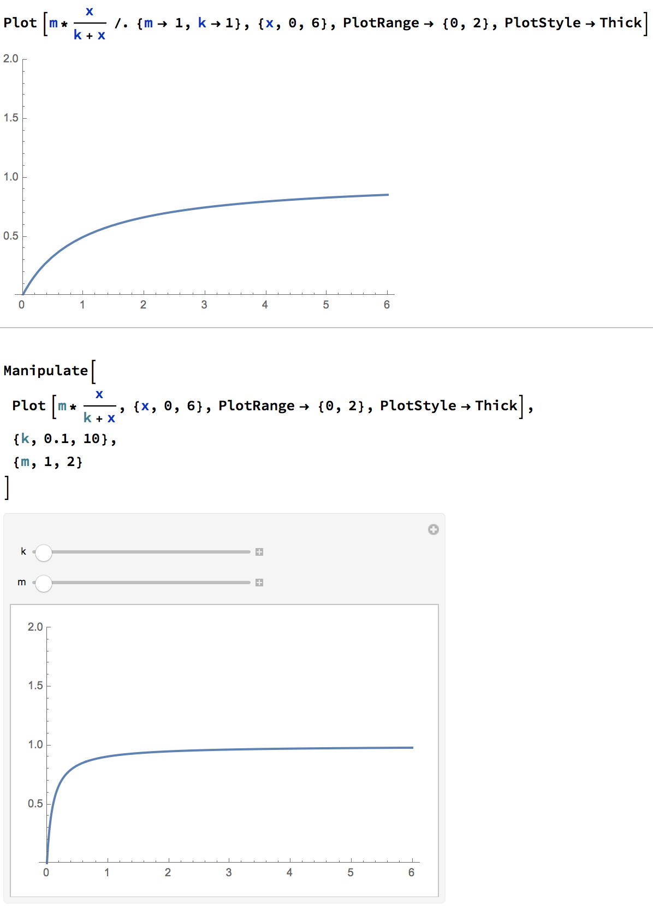
Warm-up
1c.
Make the slope and y-intercept of your straight line plot “Manipulate-able”
(Here’s an example for a hyperbolic curve)

Slide 39
Conceptual tool kit for systems biology
Functions
Exponential Function
Saturating Function
Reactions/Equations
Zero order chemical reaction
First order chemical reaction
Second Order Chemical Reaction
Stringing simple reactions together
0+1 = gene regulation
1+1 = interconversion
2+1 = binding
2+1+1 = enzyme

Slide 40
Tool kit for systems biology: Reactions
k
k
A + B C
A + B AB
k
k
A + A AA
A + B C + D
3. Second Order chemical reaction
Two biomolecules collide and then bind to each other
or destroy each other, or one destroys the other, etc
the classic chemical reaction A + B → C + D
2nd order reaction because rate determined by a two variable concentrations, [A] and [B]
Or by the same variable concentration twice in the A + A case
k is a second order rate coefficient (not a rate) with units of concentration⁻¹ time⁻¹
Note: If [B] >> [A], then we can treat [B] as a constant, and model as a first order chemical reaction
Otherwise…

Slide 41
Tool kit for systems biology: Reactions
k
A + B C
3. 2nd Order chemical reaction, continued
Differential equations
First order (only first derivatives)
Non Linear
“A+A” system has an exact solution
“A+B” system does not, but it can be solved numerically
Unit check (using rates)
[A]’
-k[A][B]
=
[A]’ = -k [A] [B]
[B]’
-k[A][B]
=
.
.
✓
μM⁻¹ s⁻¹
μM/s
μM
μM
[C]’
k[A][B]
=
This unit checking is a type of dimensional analysis

Slide 42
Concept Summary
Most non-linear systems of differential equations do not have exact solutions, and can only be modeled numerically
We will see that with the three reactions we know so far, we can build up more complicated systems of reactions

Slide 43
Tool kit for systems biology
Functions ✓
Saturating function
Exponential Function ✓
Reactions/Equations ✓
Zero order chemical reaction ✓
First order chemical reaction ✓
Second Order Chemical Reaction ✓
Stringing simple reactions together
0+1 = gene regulation
1+1 = interconversion
2+1 = binding
2+1+1 = enzyme

Slide 44
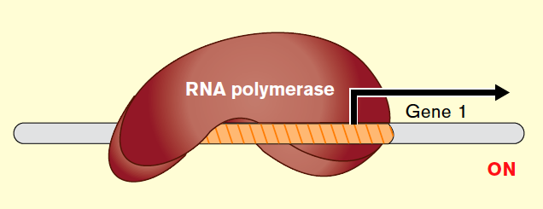

A simple model of mRNA accumulation
How does the amount of an mRNA vary as a function of the transcription rate and the mRNA degradation rate?
Y is the total number of transcripts in the cell (or test tube)
mRNA
source
sink
Zero-order (constant)
production
First order decay
e.g. r = 0.5 min⁻¹
--> t_{1/2} = 1.4 min
e.g. 3 transcripts/min

Slide 45
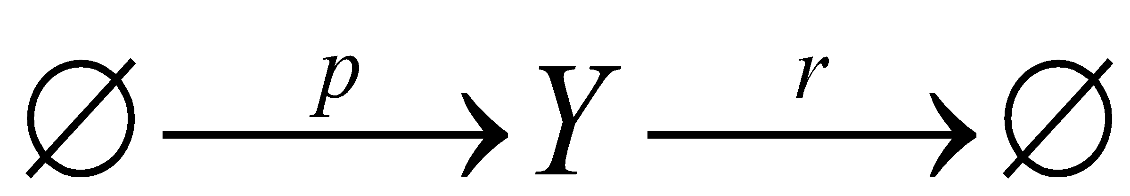
Scheme:
Y Production Rate = p
Y Destruction Rate = rY
Overall rate of change in Y is given by
production rate – destruction rate
Y’ = p – rY
Differential equation
Notes:
‹#›

Slide 46
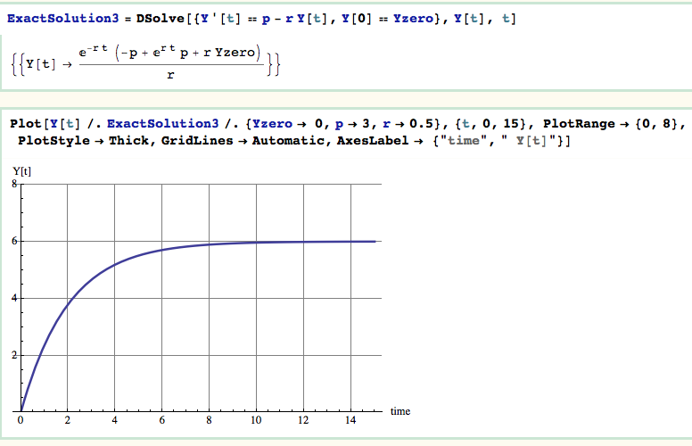
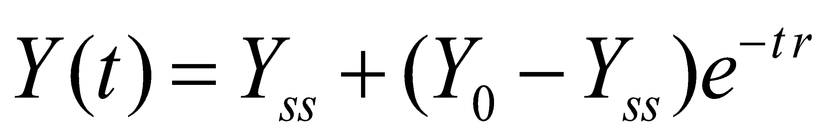
(can be put as
)
Y(t)
Exponential approach
time

Slide 47
Tool kit for systems biology
copyright 2011-2012 by Prof. Lee Bardwell, Univ. of Calif., Irvine
Functions ✓
Saturating function ✓
Exponential Function ✓
Reactions/Equations ✓
Zero order chemical reaction ✓
First order chemical reaction ✓
Second Order Chemical Reaction ✓
Stringing simple reactions together
0+1 = gene regulation ✓
1+1 = interconversion
2+1 = binding
2+1+1 = enzyme

Slide 48


Interconversion Reaction
Tool kit for systems biology
k_{f}
A
B
k_{r}
Inter-conversion reaction
A protein isomerizing between open and closed conformations
e.g. an ion channel opening and closing
A biomolecule moving between two cellular compartments
A simple model of phosphorylation/dephosphorylation
Both kf and kr are first order rate coefficients with units of time⁻¹
Differential Equations:
d [A]
-k_{f} [A] + k_{r} [B]
=
dt
d [B]
d [A]
= –
k_{f} [A] - k_{r} [B]
=
dt
dt

Slide 49
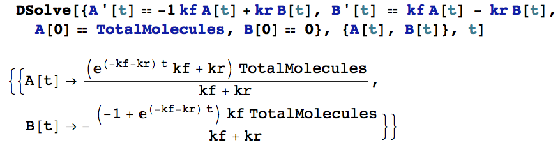
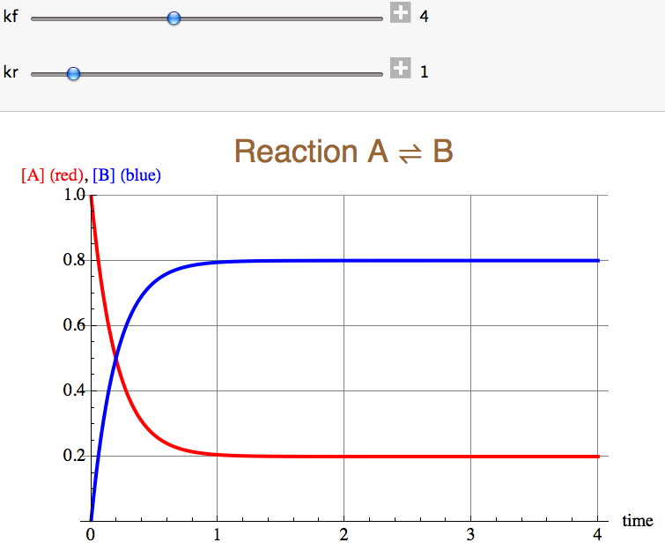

Slide 50
Tool kit for systems biology
copyright 2011-2012 by Prof. Lee Bardwell, Univ. of Calif., Irvine
Functions
Exponential Function ✓
Saturating function
Reactions/Equations ✓
Zero order chemical reaction ✓
First order chemical reaction ✓
Second Order Chemical Reaction ✓
Stringing simple reactions together
0+1 = gene regulation ✓
1+1 = interconversion ✓
2+1 = binding
2+1+1 = enzyme

Slide 51
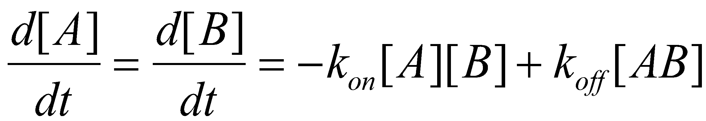
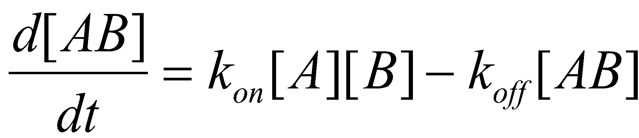
Binding Reaction
2
k_{on}
A +B
AB
k_{off}
Binding reaction
Reversible binding of A to B to form an AB complex
A and B could be two proteins that bind to form a heterodimer
A could be a transcription factor and B could be a binding site on DNA
kon is a second order rate coefficient with units of concentration⁻¹ time⁻¹
koff is a first order rate coefficient with units of time⁻¹
Differential Equations:
1

Slide 52
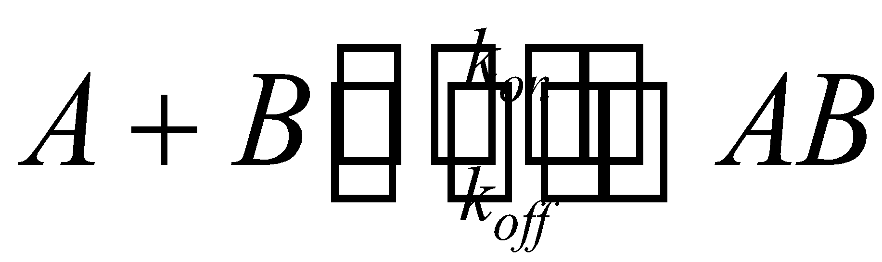
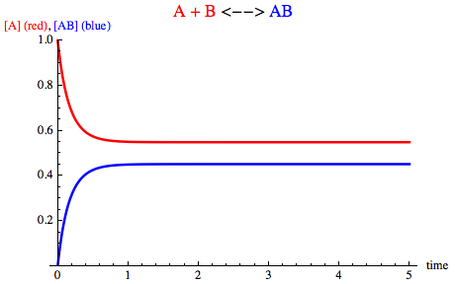
Binding Dynamics
What does the time course
of a binding reaction look like?
An exact solution of this system of differential equations is hard/impossible to get
But we can use Mathematica’s NDSolve to get a numerical solution
Associated Notebook:
“Binding+NDSolve.nb”
Or, if [B]>>[A], then we can approximate and use a first order reaction for association. Then we have the equivalent of the interconversion reaction

Slide 53
Tool kit for systems biology
copyright 2011-2012 by Prof. Lee Bardwell, Univ. of Calif., Irvine
Functions ✓
Saturating function ✓
Exponential Function ✓
Reactions/Equations ✓
Zero order chemical reaction ✓
First order chemical reaction ✓
Second Order Chemical Reaction ✓
Stringing simple reactions together
0+1 = gene regulation ✓
1+1 = interconversion ✓
2+1 = binding ✓
2+1+1 = enzyme

Slide 54
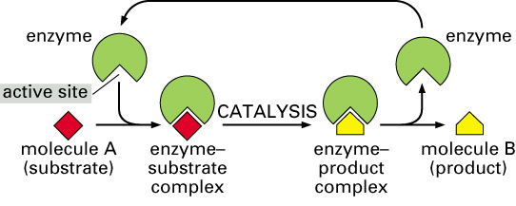
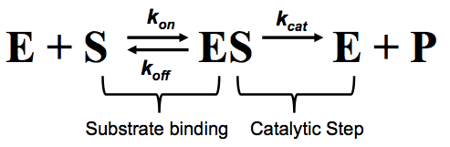
Enzymes bind, then catalyze
2
1
1

Slide 55
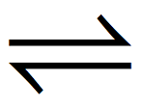
Enzymes are catalysts, they change the rate, but not the equilibrium
E+S
E+P
START HERE
END
The equilibrium amount of product formed will be the same whether the or not the enzyme is present –
But equilibrium will be reached a lot faster if the enzyme is present
‹#›

Slide 56
Enzymes are catalysts, they change the rate, but no the equilibrium
k_{cat}
ES
EP
k_{on}
k_{off}
E+S
E+P
START HERE
END
The equilibrium amount of product formed will be the same whether the or not the enzyme is present –
But equilibrium will be reached a lot faster if the enzyme is present
‹#›

Slide 57
Michaelis-Menten kinetic scheme
ES
k_{cat}
k_{on}
k_{off}
E+S
E+P
2
1
1
Note that M-M kinetics are a simplification that do not accurately model enzymes as a catalysts
‹#›

Slide 58
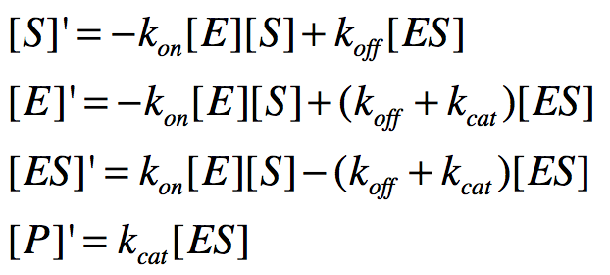
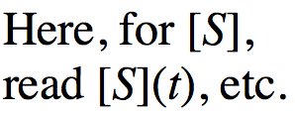
Reaction Scheme*:
k_{on}
k_{cat}
E + S ES E + P
k_{off}
Substrate binding
Catalytic Step
Differential Equations:
A simplification because it doesn’t show enzyme acting as true catalyst.
It’s a good model of the start of an enzymatic reaction, or of a reaction where product is removed, or where product formation is greatly favored.

Slide 59
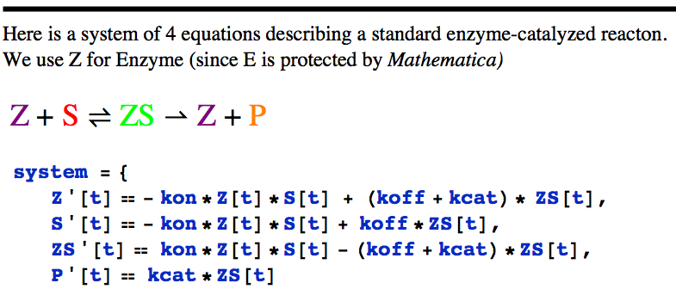
k_{on}
k_{cat}
E + S ES E + P
k_{off}
Associated Notebook:
“Enzyme Kinetics.nb”

Slide 60
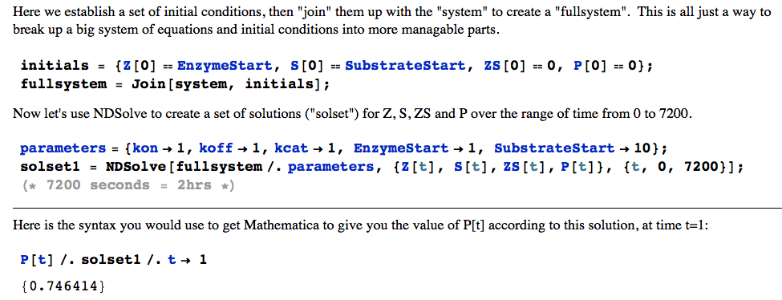
Note NDSolve
Instead of DSolve

Slide 61
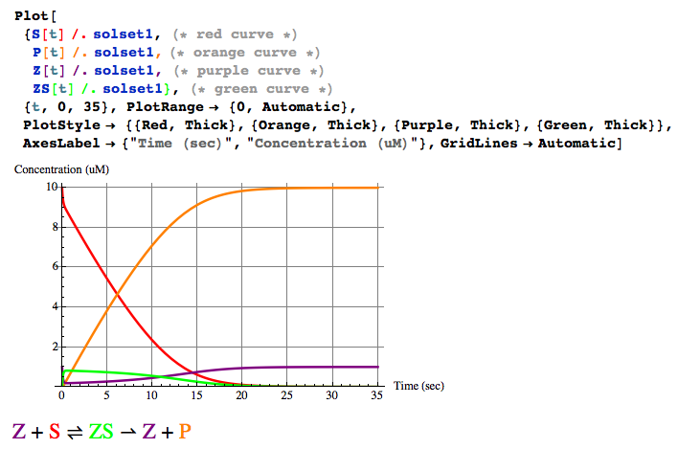
Plot the solution
Associated Notebook:
“Enzyme Kinetics.nb”

Slide 62
Tool kit for systems biology
Functions
Exponential Function ✓
Saturating function
Reactions/Equations ✓
Zero order chemical reaction ✓
First order chemical reaction ✓
Second Order Chemical Reaction ✓
Stringing simple reactions together
0+1 = gene regulation ✓
1+1 = interconversion ✓
2+1 = binding ✓
2+1+1 = enzyme ✓

Slide 63
The Fundamental Tradeoff of Systems Biology
As models become more “realistic”, it becomes harder to obtain insight from them
That said, we don’t want to “assume a spherical cow”
The best, most influential and models achieve a nice balance
between realism and insight

